Slide 1
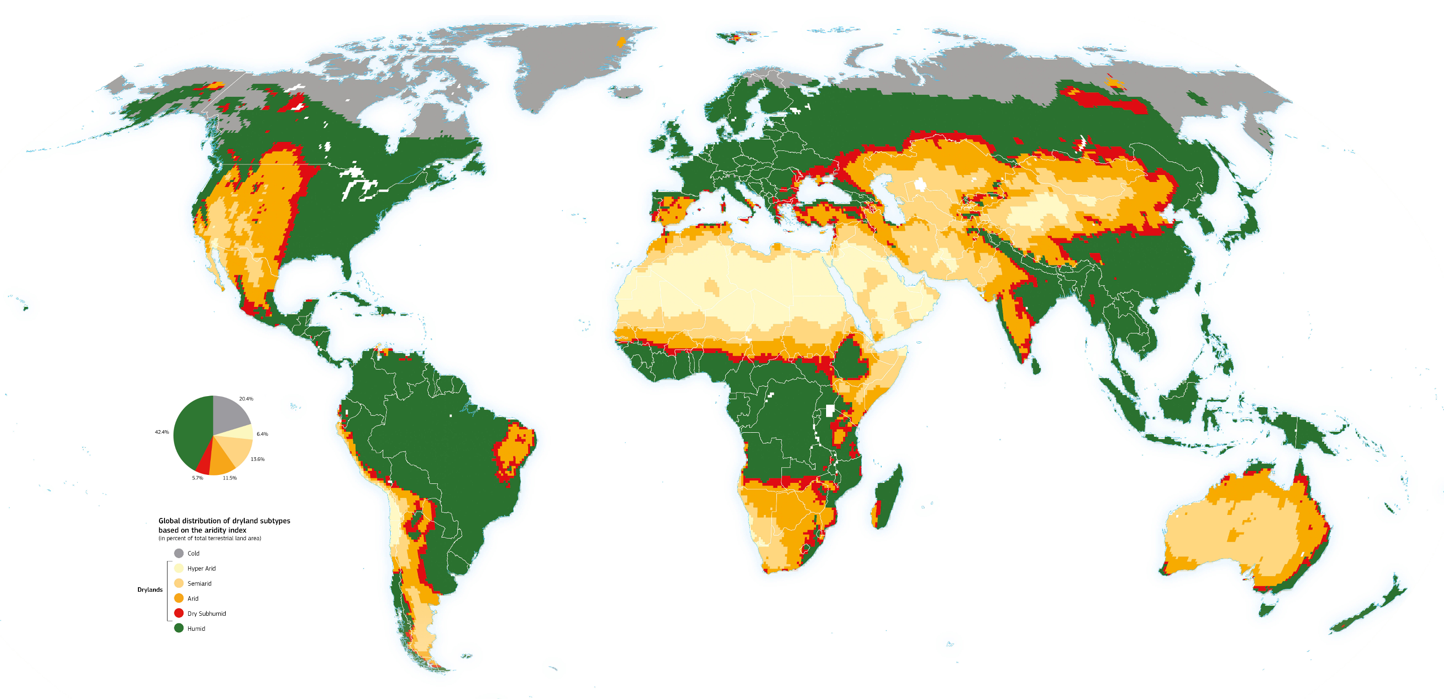
Cherlet, M., Hutchinson, C., Reynolds, J., Hill, J., Sommer, S., von Maltitz, G. (Eds.), World Atlas of Desertification, Publication Office of the European Union, Luxembourg, 2018.
Co představují různé barvy na mapě?
Notes:
Cherlet, M., Hutchinson, C., Reynolds, J., Hill, J., Sommer, S., von Maltitz, G. (Eds.), World Atlas of Desertification, Publication Office of the European Union, Luxembourg, 2018.
Image Source: Global Precipitation Climatology Centre and potential evapotranspiration data from the Climate Research Unit of the University of East Anglia (CRUTSv3.20), WAD3-JRC, modified from Spinoni J. 2015 [AP]. Retrieved from https://wad.jrc.ec.europa.eu/patternsaridity

Slide 2
Základní otázky
Jak interakce mezi lidmi a jejich prostředím ovlivňují lidi i přirozené prostředí Sahelu?
Jaké jsou příčiny a následky desertifikace Sahelu?
Proč Afrika buduje Velkou zelenou zeď?

Slide 3
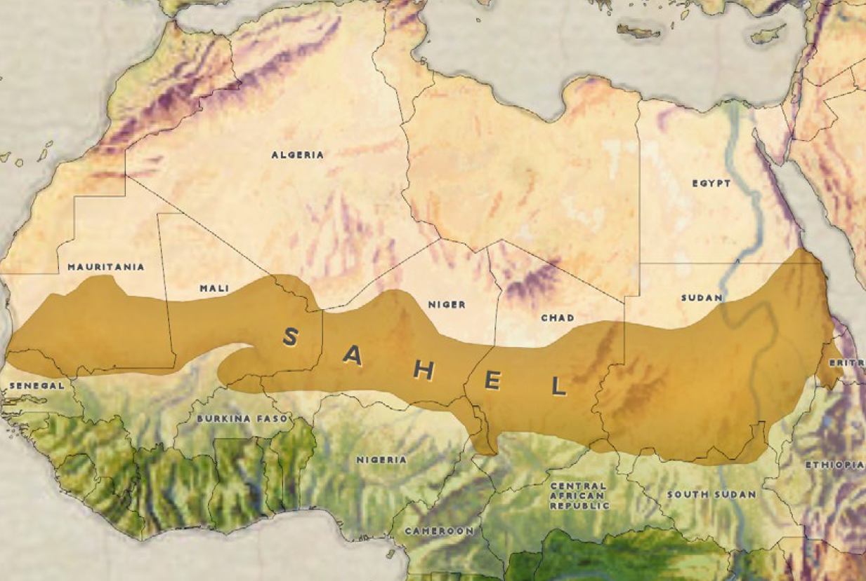
S A H A R A D E S E R T
State of New Jersey Office of Homeland Security and Preparedness. (2019, February 21). Isis West Africa Posturing for Prolonged Insurgency. Retrieved from https://www.njhomelandsecurity.gov/analysis/isis-west-africa-posturing-for-prolonged-insurgency
Notes:
Image Source: State of New Jersey Office of Homeland Security and Preparedness. (2019, February 21). Isis West Africa Posturing for Prolonged Insurgency. Retrieved from https://www.njhomelandsecurity.gov/analysis/isis-west-africa-posturing-for-prolonged-insurgency

Slide 4
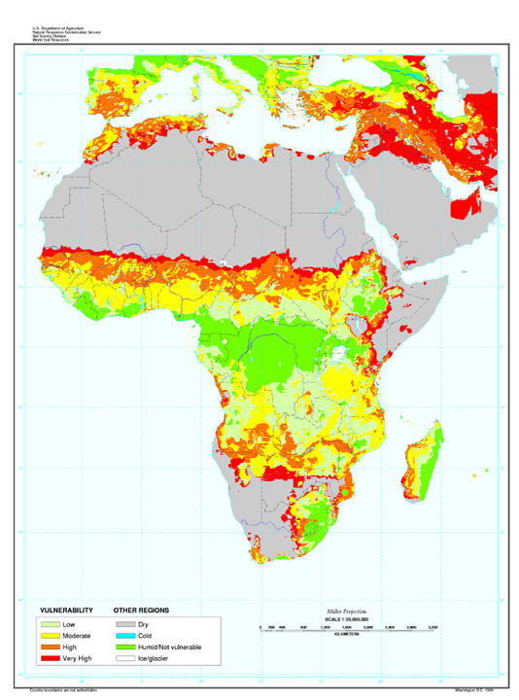
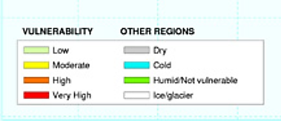
Vulnerability to Desertification
State of New Jersey Office of Homeland Security and Preparedness. (2019, February 21). Isis West Africa Posturing for Prolonged Insurgency. Retrieved from https://www.njhomelandsecurity.gov/analysis/isis-west-africa-posturing-for-prolonged-insurgency
Reich, P. F., Numbem, S. T., Almaraz, R. A., & Eswaran, H. (2019). Land resource stresses and desertification in Africa. Response to Land Degradation, 101–116. doi: 10.1201/9780429187957-12. Retrieved from https://www.nrcs.usda.gov/wps/portal/nrcs/detail/soils/use/?cid=nrcs142p2_054025
Notes:
Image sources:
State of New Jersey Office of Homeland Security and Preparedness. (2019, February 21). Isis West Africa Posturing for Prolonged Insurgency. Retrieved from https://www.njhomelandsecurity.gov/analysis/isis-west-africa-posturing-for-prolonged-insurgency
Reich, P. F., Numbem, S. T., Almaraz, R. A., & Eswaran, H. (2019). Land resource stresses and desertification in Africa. Response to Land Degradation, 101–116. doi: 10.1201/9780429187957-12. Retrieved from https://www.nrcs.usda.gov/wps/portal/nrcs/detail/soils/use/?cid=nrcs142p2_054025

Slide 5
Desertifikace je...
proces, při kterém dochází k vysychání úrodné půdy, která se tím postupně mění na poušť.
jde o pokročilou formu degradace půdy.

Slide 6
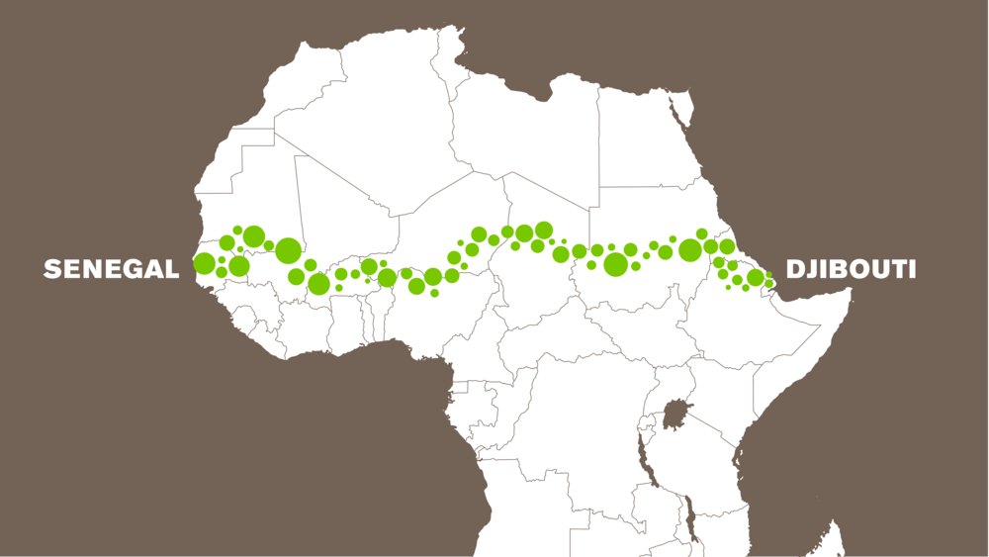
Velká zelená zeď
Great Green Wall. (n.d.). Results. Retrieved from https://www.greatgreenwall.org/results.
Notes:
Image source: Great Green Wall. (n.d.). Results. Retrieved from https://www.greatgreenwall.org/results

Slide 7
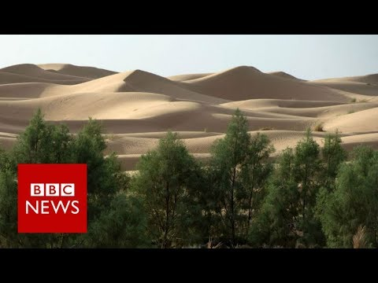
Why is Africa Building a Great Green Wall?
BBC News. (2017, September 26). Why is Africa Building a Great Green Wall? BBC News. Retrieved November 25, 2019, from https://www.youtube.com/watch?v=4xls7K_xFBQ
Notes:
Video source: BBC News. (2017, September 26). Why is Africa Building a Great Green Wall? BBC News. Retrieved November 25, 2019, from https://www.youtube.com/watch?v=4xls7K_xFBQ

Slide 8
Tweet
Pro zvýšení povědomí vytvořte tweet, který informuje veřejnost o příčinách a důsledcích desertifikace a/nebo iniciativy Velká zelená zeď.
Vaše tweety by měly být krátké, věcné výroky nebo fráze, které demonstrují, co jste se naučili.
Nearpod.com Kód: X7CS5
Notes:
https://www.unccd.int/actions/great-green-wall-initiative

